Slide 1
Design by Contract
Prof. Dr. Dirk Riehle
Friedrich-Alexander University Erlangen-Nürnberg
ADAP C04
Licensed under CC BY 4.0 International
Notes:
It is Friedrich-Alexander University Erlangen-Nürnberg – FAU, in short.
Corporate identity wants us to say “Friedrich-Alexander University”.

Slide 2
Agenda
Design by contract
Expressing contracts
Realizing contracts
Contract violations
Contracts in context

Slide 3
1. Design by Contract

Slide 4
Design by Contract
Design by contract views software design as a succession of contracting decisions [M91].
Design by Contract is method for specifying interfaces as contracts to clarify responsibilities and minimize programming effort while improving reliability [DR].

Slide 5
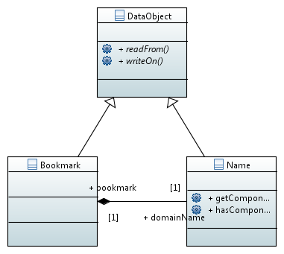
Classes Specify Object Collaborations

Slide 6
Contracts
A contract specifies rights (benefits) and obligations
  Between a client (consumer) and contractor (supplier)
  Contracts are (ideally) exhaustive; there are no hidden clauses
Rights and obligations are mutual
  A client obligation (precondition) is contractor right
  A contractor obligation (postcondition) is a client right
The contract protects both sides of the deal
  The client is guaranteed a result
  The contractor is guaranteed a specified operating environment
A contract is effectively an interface specification

Slide 7
The AbstractName#insert(...) Method
public void insert(int i, String c) {
assertClassInvariants();
assertIsValidIndex(i, getNoComponents() + 1);
assertIsNonNullArgument(c);
int oldNoComponents = getNoComponents();
doInsert(i, c);
assert (oldNoComponents + 1) == getNoComponents() : "..."; // [1]
assertClassInvariants();
}
protected abstract void doInsert(int i, String c);
[1] Please note that assertion checking using the assert keyword can be switched off;
if you require the assertion be checked, do not use assert, but a classic if clause.

Slide 8
Contract for Name#insert(...)
 | Rights | Obligations
Client | Receives Name object with component inserted | Ensures defined environment, i.e. index is valid and component != null
Contractor | Operates in defined environment | Provides Name object with component inserted

Slide 9
Defensive Programming
Defensive programming
  Wikipedia: “[...] the programmer never assumes a particular function call or library will work as advertised”
  Meyer: “[...] protect every software module by as many checks as possible, even those which are redundant with checks made by the clients.”
Problems with defensive programming
  Multiplies the amount of checking code
  Leads to bloated, hard-to-read, slow code
Redundant code is (mostly) a bad idea
  Design by contract makes code lean
  Design by contract removes redundancy

Slide 10
Benefits of Design by Contract
Leads to well-specified interfaces
Leads to clean separation of work
Makes software more reliable

Slide 11
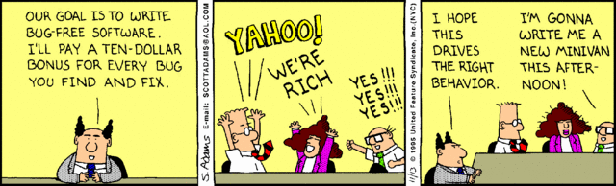
Dilbert on Bugs

Slide 12
2. Expressing Contracts

Slide 13
Expressing Contracts
Preconditions
Class invariants
Postconditions

Slide 14
Preconditions
A boolean condition to be met for successful method entry
  The purpose is to guarantee a safe operating environment
  If violated, the method should not be executed
The client must make sure preconditions are met
  A violation in the preconditions indicates a bug in the client
Preconditions are method-level components of a contract

Slide 15
Preconditions of Name#insert(...)
public void insert(int i, String c) {
assertClassInvariants();
assertIsValidIndex(i, getNoComponents() + 1);
assertIsNonNullArgument(c);
int oldNoComponents = getNoComponents();
doInsert(i, c);
assert (oldNoComponents + 1) == getNoComponents() : "...";
assertClassInvariants();
}
protected abstract void doInsert(int i, String c);

Slide 16
Postconditions
A boolean condition guaranteed after successful method exit
  If violated, the method failed to provide the service
The method must make sure postconditions are met
  A violation of a postcondition indicates a bug in the method
Postconditions are method-level components of a contract

Slide 17
Postconditions of Name#insert(...)
public void insert(int i, String c) {
assertClassInvariants();
assertIsValidIndex(i, getNoComponents() + 1);
assertIsNonNullArgument(c);
int oldNoComponents = getNoComponents();
doInsert(i, c);
assert (oldNoComponents + 1) == getNoComponents() : "...";
assertClassInvariants();
}
protected abstract void doInsert(int i, String c);

Slide 18
Class Invariants
A boolean condition that is true for any valid object
  Permanent violation of the class invariant indicates a broken object
  Temporary violation is possible during method execution
Class invariants are constraints on the object’s state space
  The class (implementation) must make sure its invariants are maintained
Class invariants are class-level components of a contract

Slide 19
Class Invariants of Name
public void insert(int i, String c) {
assertClassInvariants();
assertIsValidIndex(i, getNoComponents() + 1);
assertIsNonNullArgument(c);
int oldNoComponents = getNoComponents();
doInsert(i, c);
assert (oldNoComponents + 1) == getNoComponents() : "...";
assertClassInvariants();
}
protected abstract void doInsert(int i, String c);
protected void assertClassInvariants() {
assert getNoComponents() >= 0;
...
}

Slide 20
3. Realizing Contracts

Slide 21
Realizing Design by Contract
Annotate interface with class invariants
Annotate methods with pre- and postconditions

Slide 22
Implementing Design by Contract
In Java, use assert or assertion methods
  Preconditions guard the entry to the method
  Postconditions ensure successful completion
  Class invariants add to postconditions
Assertions should be side-effect free
  Do not call mutation methods

Slide 23
Use of Assertion Methods
Use dedicated assertion method if …
  the assertion is used more than twice
  a generic assertion failure exception is insufficient
  you want to avoid that your assertion checking can be switched off
protected void assertIsValidIndex(int i, int upperLimit)
throws IndexOutOfBoundsException {
if ((i < 0) || (i >= upperLimit)) {
String msg = String.valueOf(i) + "(of " +
String.valueOf(getNoComponents()) +")";
throw new IndexOutOfBoundsException(msg);
}
}

Slide 24
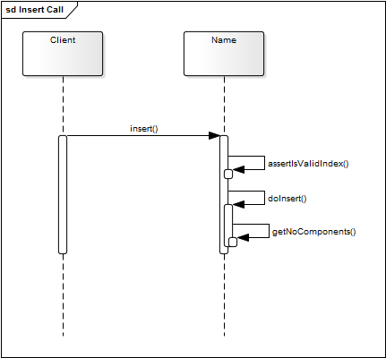
Design by Contract and Assertions

Slide 25
Semantics of Various Exceptions
IllegalArgumentException
IndexOutOfBoundsException
NullPointerException
IllegalStateException
...

Slide 27
4. Contract Violation

Slide 28
Normal vs. Abnormal Operation
Normal situation
  “All is good” about the program; system is performing its function
  Program pointer is in regular code, not exception handling code
Abnormal situation
  A contract was violated; the system needs to recover from the violation
  Violation is detected by failing pre- and postconditions, class invariants
Modern programming languages distinguish both modes
  Contract violation leads to exceptions being thrown
  Exception handling takes place outside regular code

Slide 29
Contracts and Control Flow [1]
 | Control Flow
 | Normal Return by return | Abnormal Return by Exception
Contract Fulfilled | x | –
Contract Not Fulfilled | – | x
[1] Meyer’s first two “laws” of exception handling reframed.

Slide 30
Handling Contract Violations
Handling an Exception
Resumption
Organized Panic
More on this in lecture on error handling

Slide 31
Two Alternatives of Handling Violations
Resumption
  Try again
  Try alternative implementation
Organized panic
  Clean up as far as possible
  Repackage exception, pass on

Slide 32
Quiz: Switching off Assertions
Should you switch off assertions? (If so, when?)
  Yes
  No

Slide 33
5. Contracts in Context

Slide 34
Pragmatics of Design by Contract
Use design by contract ...
  for code that needs to be highly reliable
  for code that is called often
Focus on preconditions ...
  to protect method operations
  to document expectations
Why not postconditions and class invariants?
  One method’s postconditions are another method’s precondition
  Class invariants are implied postconditions for all methods
  Pragmatically, tests already check for contract fulfillment

Slide 35
Design by Contract and Multithreading
public void insert(int i, String c) {
assertIsValidIndex(i, getNoComponents() + 1);
assertIsNonNullArgument(c);
int oldNoComponents = getNoComponents();
doInsert(i, c);
assert (oldNoComponents + 1) == getNoComponents() : "...";
}
protected void doInsert(int index, String component) {
int newSize = getNoComponents() + 1;
String[] newComponents = new String[newSize];
for (int i = 0, j = 0; j < newSize; j++) {
if (j != index) {
newComponents[j] = components[i++];
} else {
newComponents[j] = component;
}
}
components = newComponents;
}

Slide 36
Design by Contract and Inheritance
Preconditions may “accept more cases”
  Subclasses may require less (weaken preconditions)
    Preconditions get disjunctively (“or”) connected
  Subclasses may contravariantly redefine method argument types
Postconditions may “provide better results”
  Subclasses may provide more (strengthen postconditions)
    Postconditions get conjunctively (“and”) connected
  Subclasses may covariantly redefine return type
Class invariants may “provide better results”
  Subclass invariants may not require less
  If they provide more, they must refine superclass invariants

Slide 37
Preconditions and super.method() Calls
Ensure preconditions of super.method(...) before using it
public Name AbstractName#insert(int index, String component) {
assertIsValidIndex(index, getNoComponents() + 1);
return doInsert(index, component);
}
public LazyName LazyName#insert(int index, String component) {
ensureLength(index);
return super.insert(index, componenht);
}
protected void ensureLength(int length) {
// extend internal representation with empty components
...
}

Slide 38
Postconditions and Dual Hierarchies
Covariant redefinition of return type strengthens postcondition
public Name AbstractName#insert(int index, String component) {
assertIsValidIndex(index, getNoComponents() + 1);
return doInsert(index, component);
}
public LazyName LazyName#insert(int index, String component) {
ensureLength(index);
return super.insert(index, component);
}
protected void ensureLength(int length) {
// extend internal representation with empty components
...
}

Slide 39
Quiz: Violating Class Invariants
Can you violate a class invariant in between two methods calls?
  Yes
  No

Slide 40
Review / Summary of Session
Design by contract
  Definition, modeling, and realization
  Design by contract in Java
  Handling violations
Design-by-contract in context
  Multi-threading
  Inheritance

Slide 41
Thank you! Questions?
dirk.riehle@fau.de – https://oss.cs.fau.de
dirk@riehle.org – https://dirkriehle.com – @dirkriehle
DR

Slide 42
Legal Notices
License
  Licensed under the CC BY 4.0 International License
Copyright
  © 2012-2021 Dirk Riehle, some rights reserved

